Slide 1
The Wonderful World Of Operating Systems
How does the computer get anything done?

Slide 2

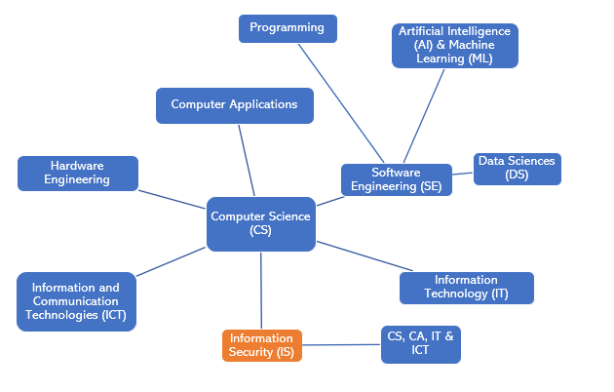
What does Computer Sciences look like?

Slide 3
Some history of amazing minds
The genius minds of Charles Babbage, Alan Turing and Von Neumann had it all figured out for us!
Find out more about them!
Better yet –Watch the movie: “The Imitation Game”
And check this out: http://www.rutherfordjournal.org/article040101.html

Slide 4
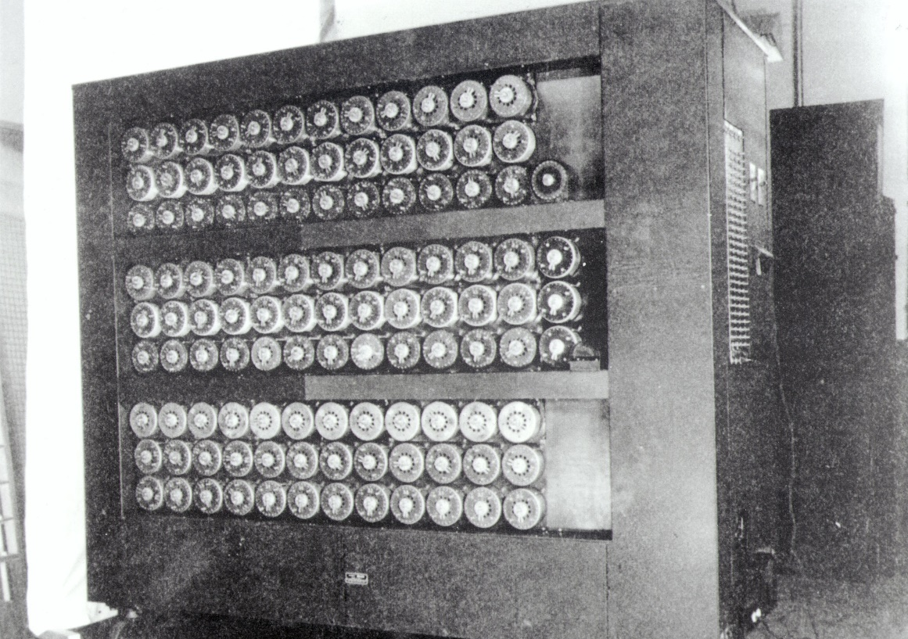
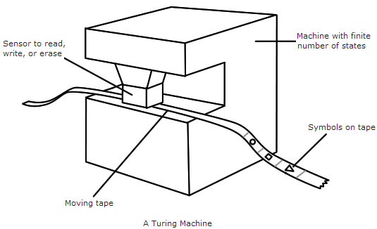
Turing’s Machine – An All-Purpose Computer?
https://medium.com/personal-growth/alan-turing-how-to-change-history-twice-in-a-single-moment-5cfdb47b8e8d

Slide 5
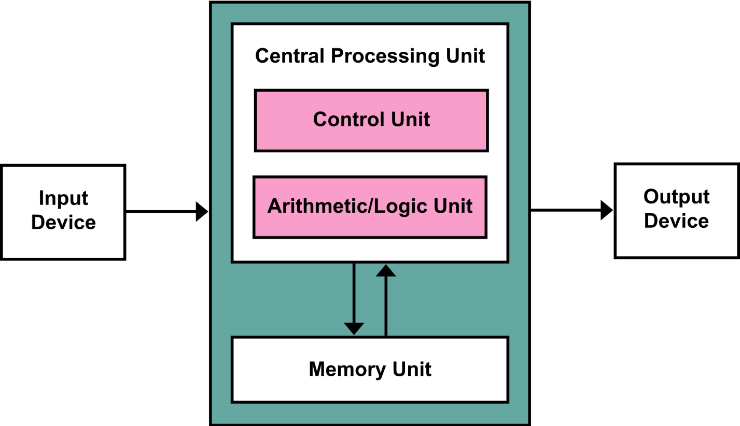
Von Neumann Architecture
https://en.wikipedia.org/wiki/Von_Neumann_architecture#/media/File:Von_Neumann_Architecture.svg

Slide 6
So what does an OS do?
Scheduling
Interrupt Handling
Memory Management
Resource Management
Hardware Management
User Management
Security
Network Management

Slide 7
MIT Open Courseware (OSW)
Did you know you could access many great lectures from MIT on their open sharing platform? See this on their Computer System Engineering Page
https://ocw.mit.edu/courses/electrical-engineering-and-computer-science/6-033-computer-system-engineering-spring-2018/

Slide 8
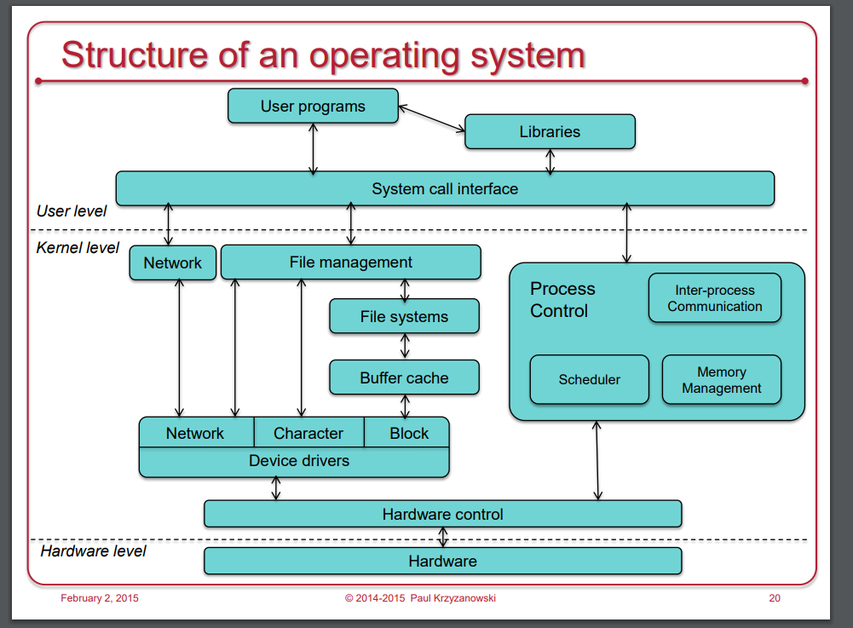
Background
Here’s another great resource if you want to explore more
https://www.cs.rutgers.edu/~pxk/416/notes/index.html

Slide 9
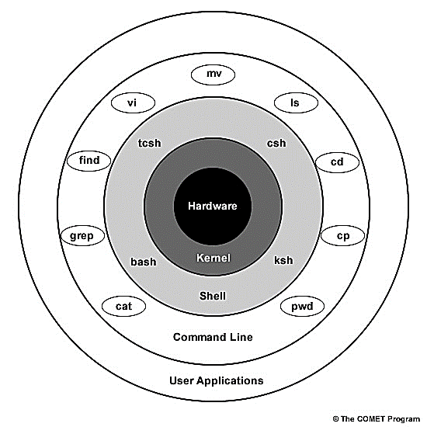
Unix https://www.meted.ucar.edu/ucar/unix/navmenu.php?tab=1&page=2-1-0&type=flash
Kernel programs use “System calls” – a type of special programs used to interact with the hardware
All other layers starting with the shell communicate via the kernel
Programs written for these layers could be in a high level language

Slide 10
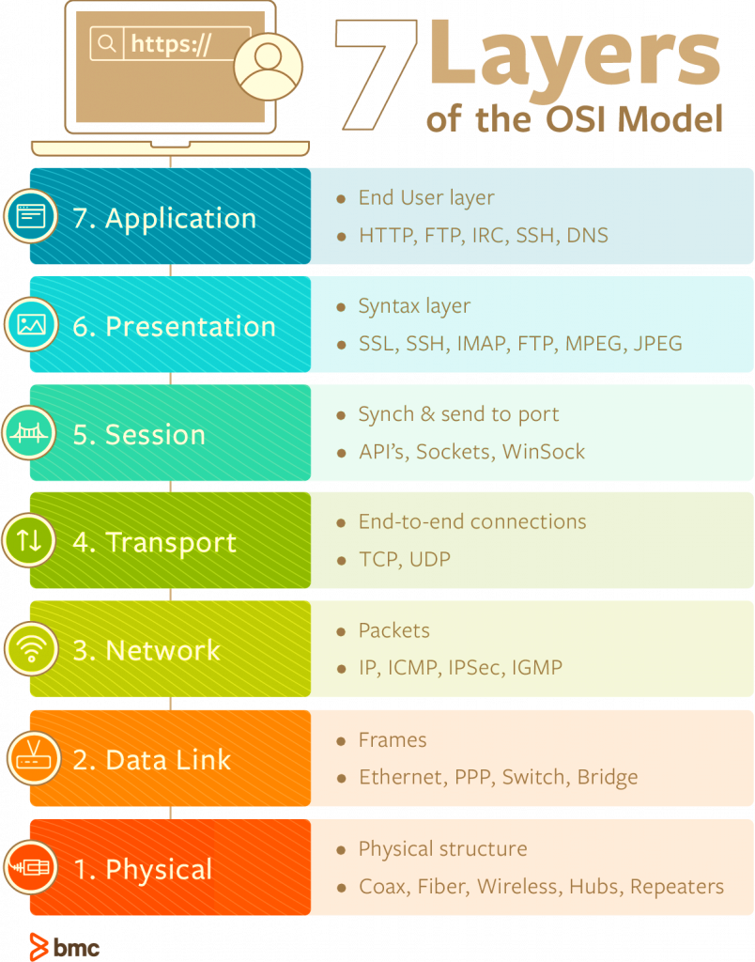
Network OS
“Please Do Not Throw Sandwiches & Pastries Away!” (PDNTSPA)
https://www.bmc.com/blogs/osi-model-7-layers/
https://software.intel.com/en-us/articles/the-advantages-of-using-virtualization-technology-in-the-enterprise

Slide 11
Distributed Systems
Project Athena happened right here in MIT! They created the world’s first Distributed system
The story goes that folks at MIT wanted to do something exciting for their Undergraduate curriculum
So a 5-year project was created with help from DEC and Intel. Later, this was extended to another 3 years
You can read more about this here http://tech.mit.edu/V119/N19/history_of_athe.19f.html

Slide 12
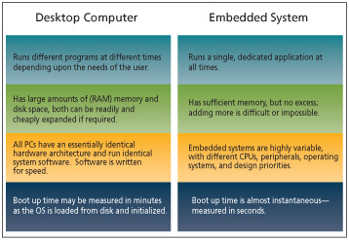
Desktop OS
https://www.techdesignforums.com/practice/technique/linux-nucleus-or-both/

Slide 13
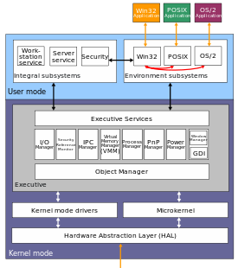
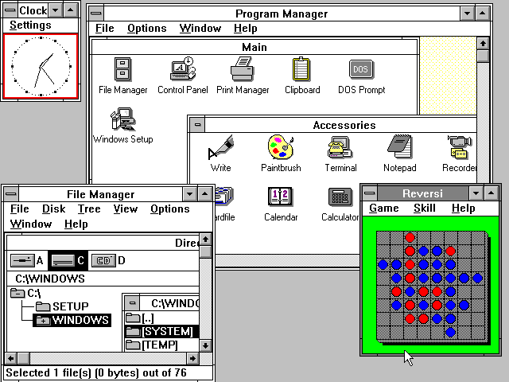
Windows before the glamour
https://en.wikipedia.org/wiki/Microsoft_Windows
https://en.wikipedia.org/wiki/Architecture_of_Windows_NT

Slide 14
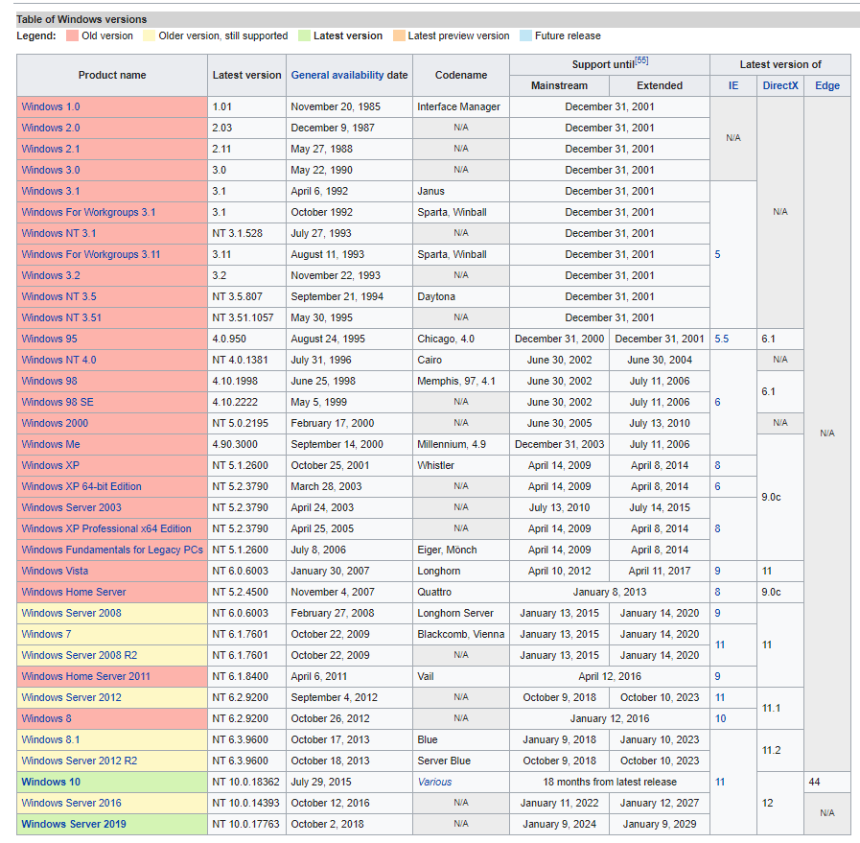
Windows Versions
https://en.wikipedia.org/wiki/Microsoft_Windows

Slide 15
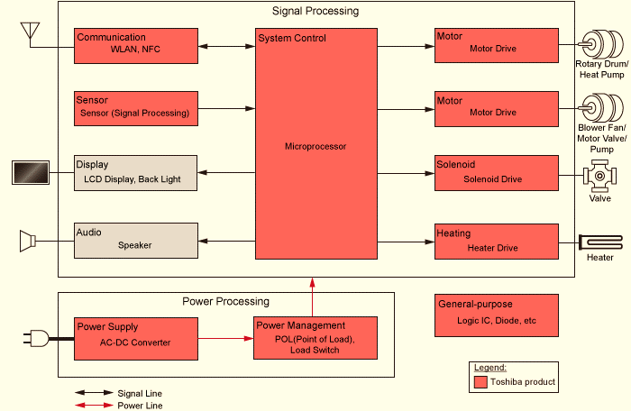
Embedded OS
What is it “embedded” in?
Does it have an “Interface”?
https://toshiba.semicon-storage.com/us/application/consumer/white-goods/washing-machine.html

Slide 16
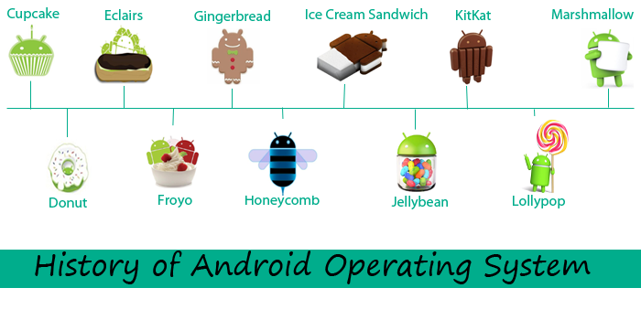
Mobile OS
IOS (iPhone OS)
Android (dessert-inspired names appearing in alphabetical order – but soon ending with Android 10)
Cupcake (1.5), Donut (1.6), Eclair (2.0-1), Froyo (2.2), Gingerbread (2.3), Honeycomb (3.0-2), Ice Cream Sandwich (4.0), Jelly Bean (4.1-3), KitKat (4.4), Lollipop (5.0-1), Marshmallow (6.0), Nougat (7.0-1), Oreo (8.0-1), to today's Android 9 Pie.
Symbian (By Symbian for Nokia: RIP!)
Bada By Samsung: RIP!)
RIM (By Research In Motion: Blackberry)
Windows Mobile OS (By Microsoft: RIP!)
https://androidtutorial663.wordpress.com/2016/03/11/androidandroid-tutorial-android-app-developmentandroid-development/

Slide 17
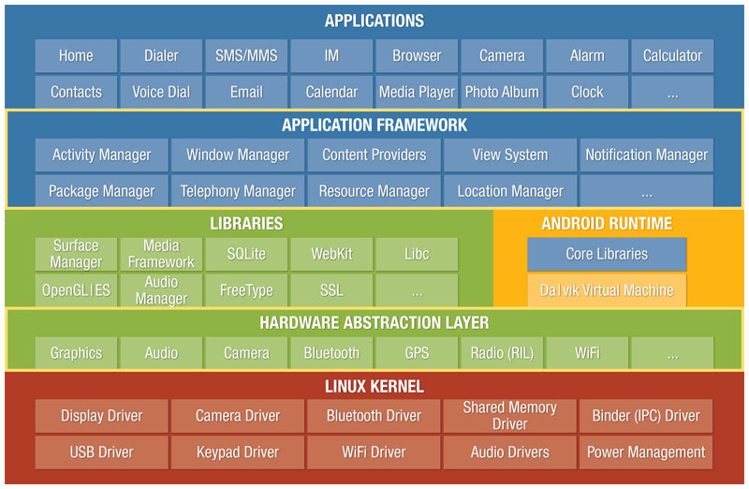
Android OS
https://manifestsecurity.com/android-application-security-part-2/
https://www.developer.com/ws/android/programming/guide-to-porting-android-applications-to-windows-8.html

Slide 18
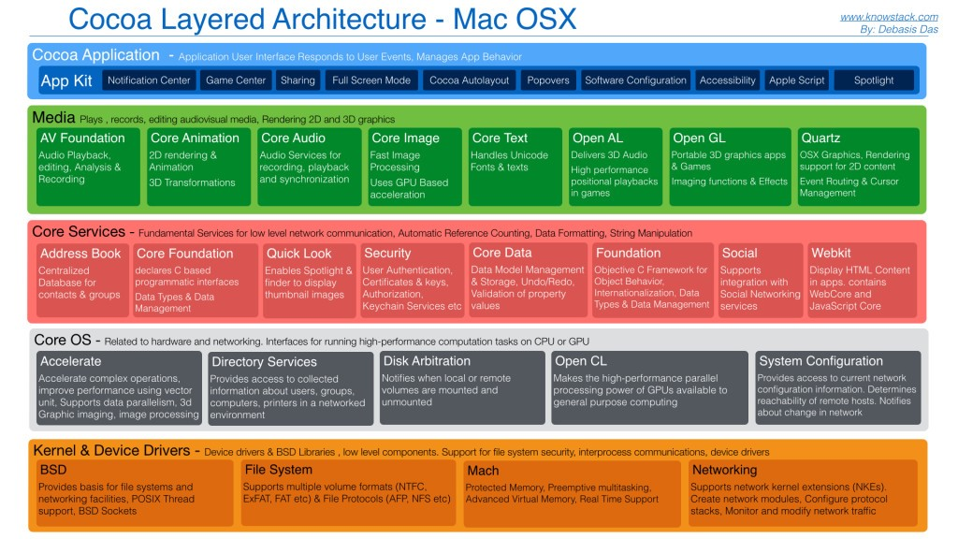
iPhone OS architecture
https://developer.apple.com/library/archive/documentation/MacOSX/Conceptual/OSX_Technology_Overview/CoreOSLayer/CoreOSLayer.html
https://intellipaat.com/blog/tutorial/ios-tutorial/ios-architecture/
http://www.knowstack.com/cocoa-layered-architecture-for-mac-osx/

Slide 19
IOS vs. Android
Here’s a great blog written in 2017, by Maziyah from University of Brighton, UK
http://blogs.brighton.ac.uk/misseloquence/2017/05/09/comparing-ios-and-android-the-architecture-and-development-environment-of-the-two-most-popular-operating-systems/

Slide 20
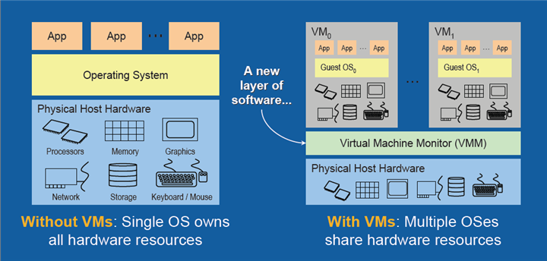
Virtual OS
With a virtual machine interface, we could run several OS’s
The hardware now become available like a “service” to any OS!

Slide 21
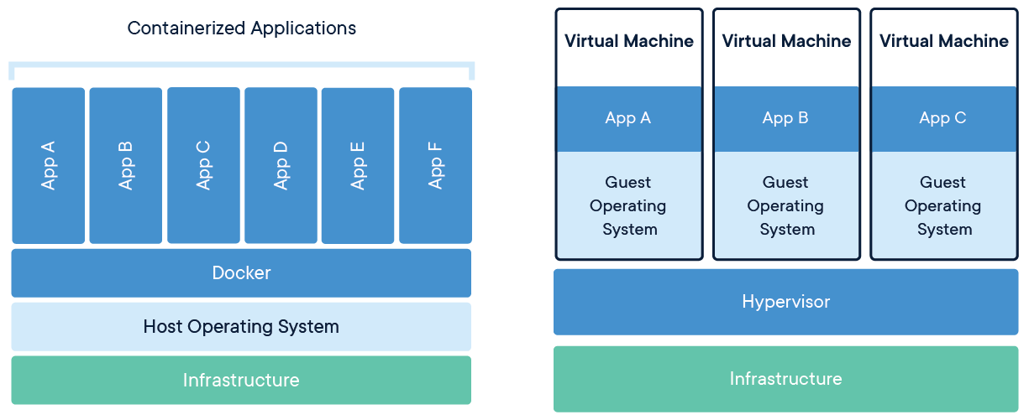
Containers (Docker)
https://www.docker.com/resources/what-container

Slide 22
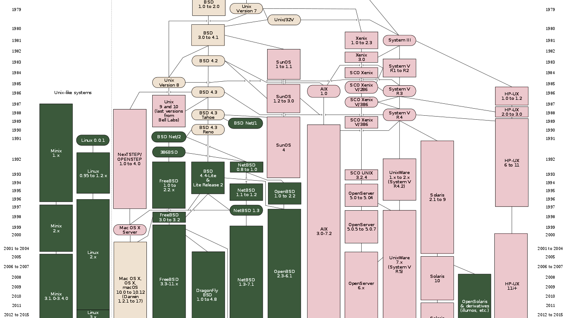
Unix And Its Copy-cats ;)
https://en.wikipedia.org/wiki/Unix

Slide 23
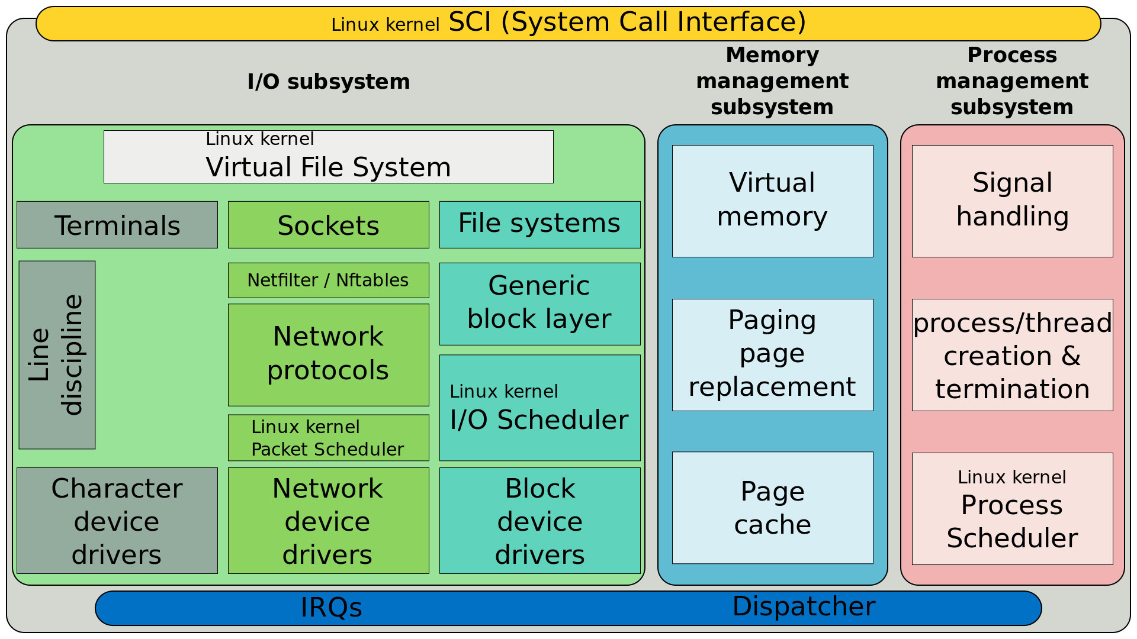
Linux Anatomy
By ScotXW - Own work, CC BY-SA 4.0, https://commons.wikimedia.org/w/index.php?curid=47075153

Slide 24
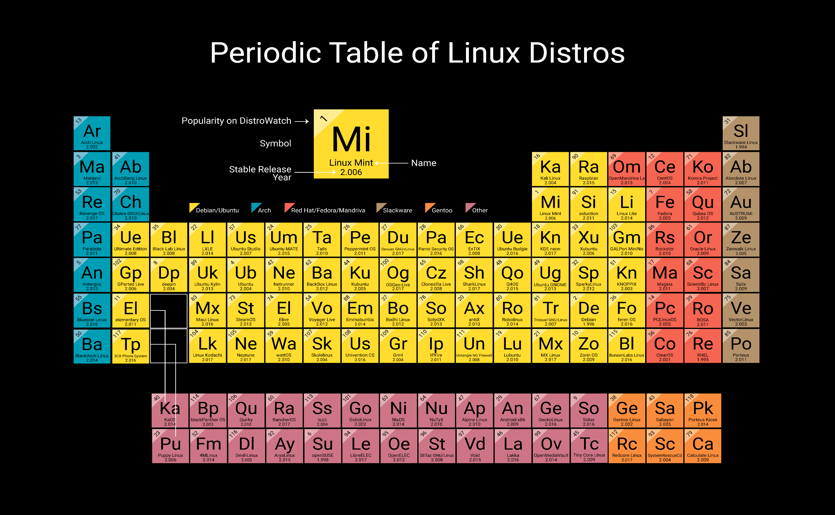
https://distrowatch.com/images/other/periodic-table-of-distro.png

Slide 25
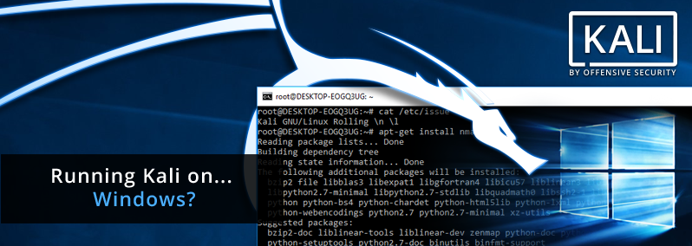
Specialised OS (Kali – a Linux Distro)
Used for security testing aka penetration testing aka hacking
Free Kali Training! https://kali.training/

Slide 26

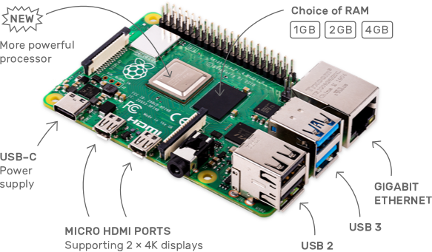
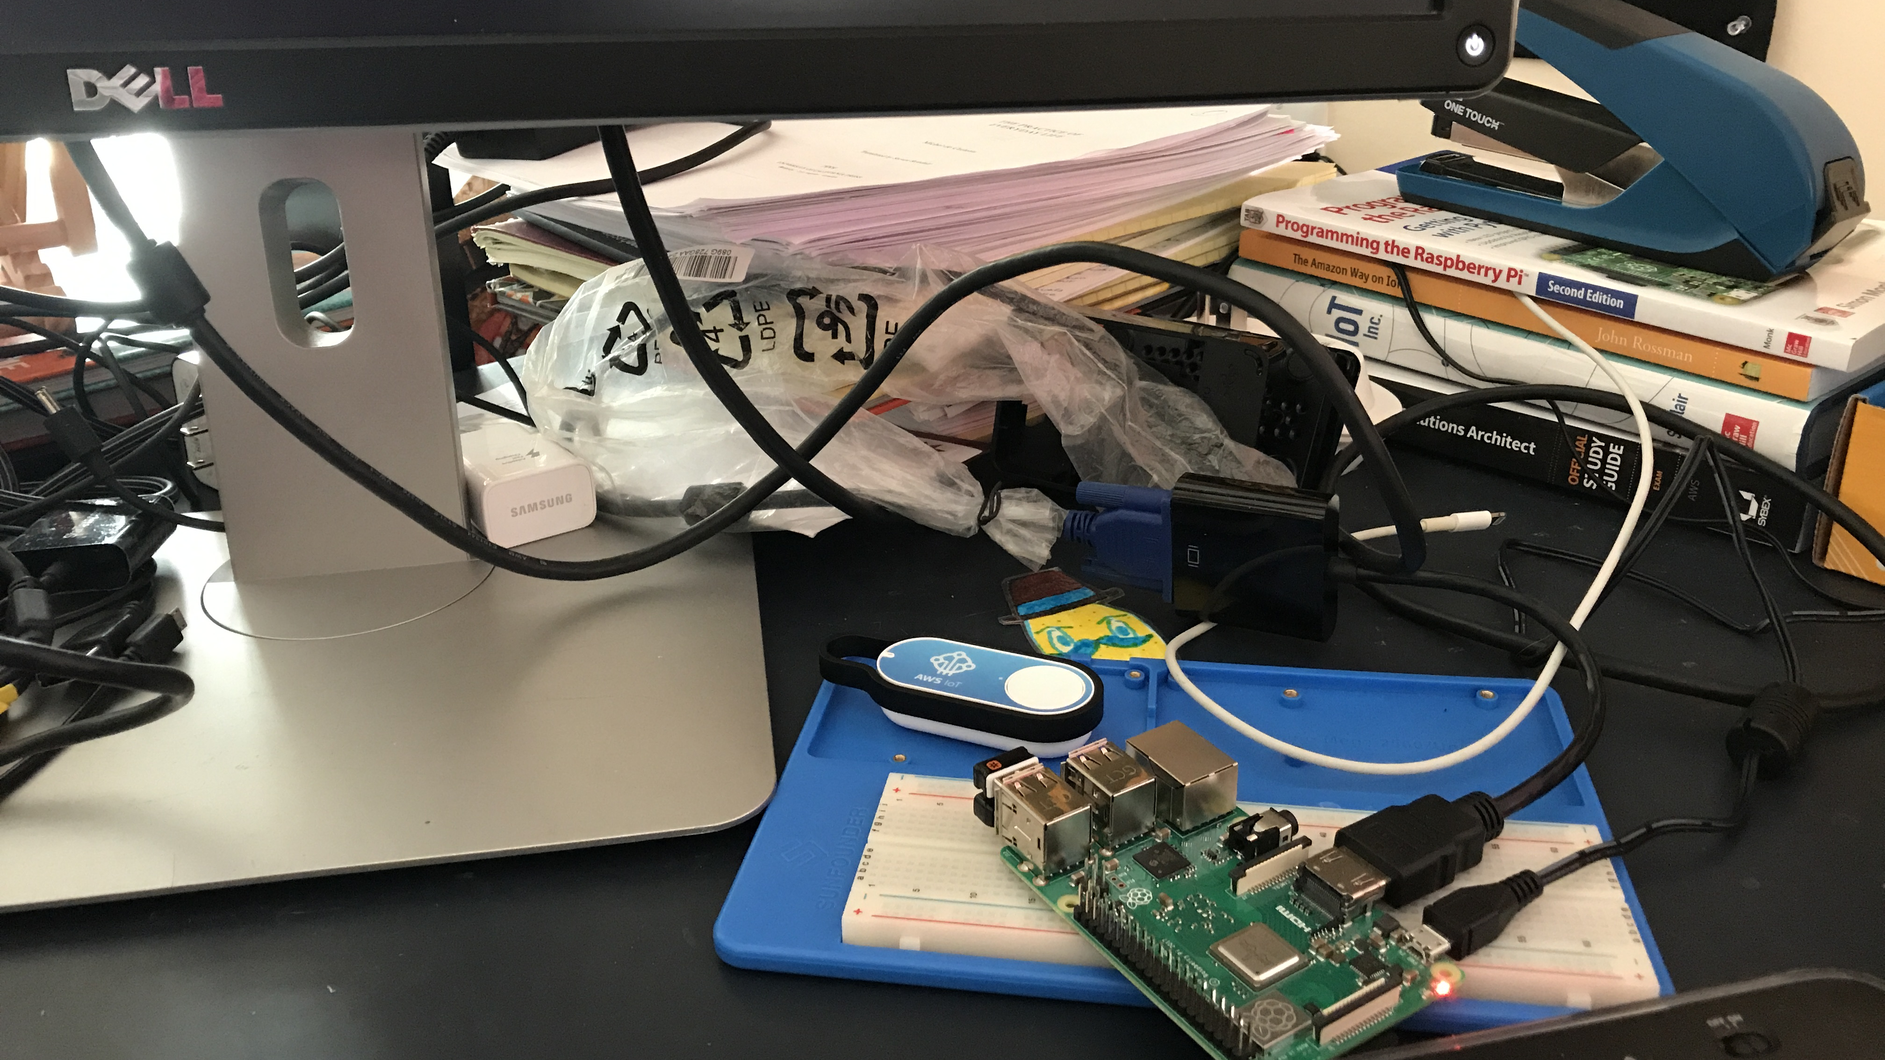
https://en.wikipedia.org/wiki/raspberry_pi https://www.raspberrypi.org/products/raspberry-pi-4-model-b/
the raspberry pi – and that’s my RASPI!
1.2 GHz 64-bit quad core CPU, ARM v7 Debian Stretch
1 GB RAM
4 USB ports
1 micro-USB port
1 HDMI slot
3.5 mm mini jack for AV
1 ethernet port
And all other usual stuffing that go into a raspberry pi

Slide 27
Join me Round! [15 mins Prep + @3 min teach ~ 30 mins]
Timesharing Vs. Batch Processing
Timesharing Vs. Realtime OS
Online vs. Realtime
Multi-tasking vs. Parallel Processing
https://www.tutorialspoint.com/operating_system/os_types.htm

Slide 28
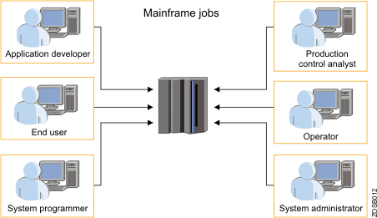
Mainframe OS (time sharing/multi tasking)
https://www.ibm.com/support/knowledgecenter/zosbasics/com.ibm.zos.zmainframe/zconc_whatismainframe.htm

Slide 29
All the rest etc., etc., etc.,
Software Development Kit (SDK)
Framework
Application Programming Interface (API)
Package
Module
Dynamic Link Library (DLL) or Library files (Lib)
Executable (EXE)

Slide 30
Some useful terms to explore further
Container
Shell
UI
IPC
Daemon
Device Driver
Graphical User Interface
Guest
Host
Virtual
Hypervisor
Kernel
Process
Command Line Environment
Network Interface
Protocol
Buffer
Cache
Interrupts
Threads
System Calls

Slide 31
Teach me Round – Part 2 [15 min Prep @3 min teach = 30 mins]
Buffer Vs. Cache
Guest VM vs. hypervisor
Guest OS Vs. Host OS
Paging Vs. Swap file
Virtual memory vs. swap file

